Slide 1

NAME – ABHIRUP BAG ROLL – 13000122082 DEPARTMENT – CSE(B) SEMESTER – 6 PAPER – Pattern recognition(pec-it602d)
NON-PARAMETRIC ESTIMATION

Slide 2

content
Introduction
Key CONCEPTS
Common Non-parametric Methods
Kernel Density Estimation (KDE)
Histogram Estimation
Nearest Neighbor Estimation
Empirical Cumulative Distribution Function (ECDF)
Spline & Local Polynomial Regression (LOESS)
Advantages & Disadvantages of Non-Parametric Estimation
Applications
Conclusion
3
4
5
6 - 8
9 - 11
12 - 14
15 - 17
18 - 20
21
22
23

Slide 3
INTRODUCTION
What is Non-Parametric Estimation?
A statistical method that makes minimal assumptions about data distribution.
Unlike parametric methods, it does not assume a fixed functional form.
Why is it Important?
Useful for analyzing real-world data with unknown or complex distributions.
Provides more flexibility in modeling.

Slide 4
Key CONCEPTS
No Fixed Parameters : Unlike parametric methods (e.g., normal distribution with mean and variance), non-parametric methods do not assume a predefined shape for the data distribution.
Data-Driven Approach : These methods rely on the structure of the observed data to make inferences.
More Flexible but More Data Needed : Non-parametric methods adapt to data patterns but often require larger sample sizes to achieve similar accuracy as parametric methods.

Slide 5
Common Non-parametric Methods
Kernel Density Estimation (KDE)
Histogram Estimation
Nearest Neighbour Estimation
Empirical Cumulative Distribution Function (ECDF)

Slide 6

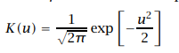
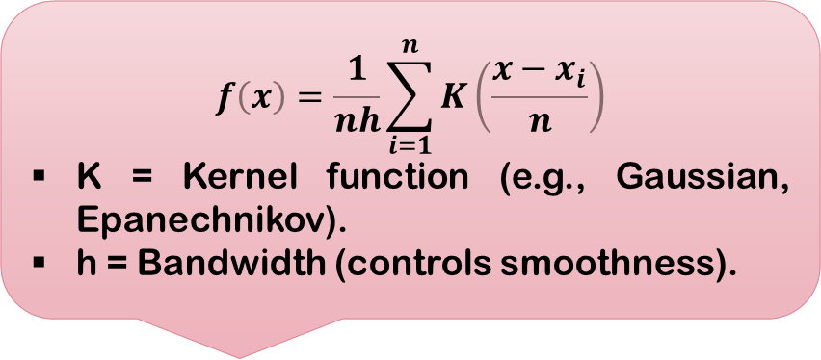
Kernel Density Estimation (KDE)
Definition :
Formula :
A method to estimate a probability density function (PDF) by smoothing observed data.
$$f\left(x\right)=\frac{1}{nh}\sum_{i=1}^{n}{K\left(\frac{x−x_{i}}{n}\right)}$$
K = Kernel function (e.g., Gaussian, Epanechnikov).
h = Bandwidth (controls smoothness).
Gaussian Kernel

Slide 7
Python Code :
import numpy as np
from scipy.stats import norm
from sklearn.neighbors import KernelDensity
# Kernel Density Estimator using gaussian kernel
X = np.random.randn(100)
model = KernelDensity(kernel='gaussian',
bandwidth=0.2)
model.fit(X[:, None])
new_data = np.linspace(-5, 5, 1000)
density = np.exp(model.score_samples(new_data[:, None]))
# print(new_data)
# Plot the densities
plt.plot(new_data, density, '-',
color='red')
plt.xlabel('Data')
plt.ylabel('Density')
plt.title('Kernel Density Estimator using Gaussian kernel')
plt.show()

Slide 8

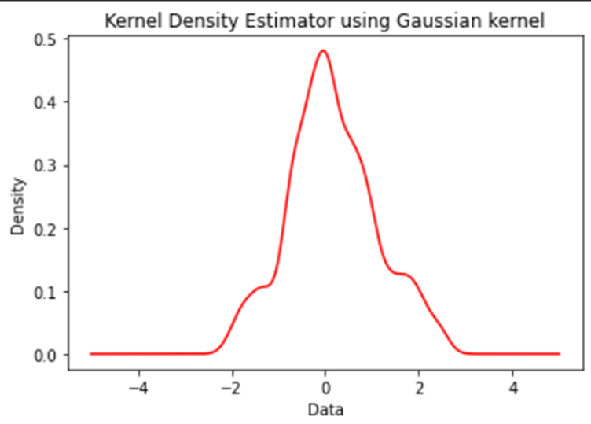
Output

Slide 9
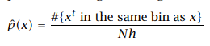
Histogram Estimation
What is a histogram?
Pros and Cons :
Splits the data range into bins and counts the frequency of values in each bin.
A simple method to estimate probability density.
𝑷𝒓𝒐𝒔: 𝑺𝒊𝒎𝒑𝒍𝒆 𝒂𝒏𝒅 𝒆𝒂𝒔𝒚 𝒕𝒐 𝒊𝒏𝒕𝒆𝒓𝒑𝒓𝒆𝒕.
𝑪𝒐𝒏𝒔: 𝑯𝒊𝒈𝒉𝒍𝒚 𝒔𝒆𝒏𝒔𝒊𝒕𝒊𝒗𝒆 𝒕𝒐 𝒃𝒊𝒏 𝒘𝒊𝒅𝒕𝒉 𝒔𝒆𝒍𝒆𝒄𝒕𝒊𝒐𝒏.
Histogram estimator

Slide 10
Python Code to plot a histogram
import numpy as np
def hist_pdf(x, data, n_bins=2,
minv=None, maxv=None):
if minv is None:
minv = np.min(data)
if maxv is None:
maxv = np.max(data)
d = (maxv-minv) / n_bins
bins = np.arange(minv, maxv, d)
bin_id = int((x-minv)/d)
bin_minv = minv+d*bin_id
bin_maxv = minv+d*(bin_id+1)
n_data = len(data)
y = len(data[np.where((data > bin_minv)\
& (data < bin_maxv))])
pdf = (1.0/d) * (y / n_data)
return pdf
from sklearn.datasets import load_boston
import matplotlib.pyplot as plt
ds = load_boston()
data = ds['target']
# Demo histogram
xvals = np.arange(min(data), max(data), 1)
n_bins = 15
pdf = [hist_pdf(x, data, n_bins=n_bins) for x in xvals]
plt.xlabel('Data')
plt.ylabel('Density')
plt.title('Histogram Density Estimation')
plt.plot(xvals, pdf)
plt.show()

Slide 11
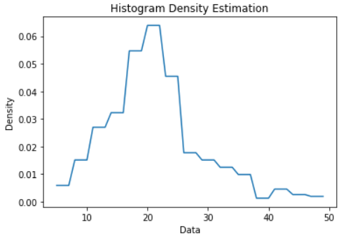
Output

Slide 12


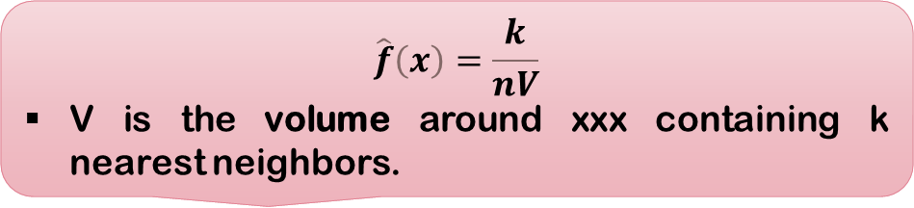
Nearest Neighbor Estimation (k-NN Density Estimation)
What is Nearest Neighbor Estimation?
Strengths & Weaknesses:
✔ Works well for high-dimensional data.
✘ Computationally expensive, especially for large datasets.
Determines the density of a point based on the distance to its k-nearest neighbor.
Provides a local density estimate based on proximity to other data points.
📌 Example: Used in anomaly detection (e.g., fraud detection in banking transactions).
Formula :
$$\hat{f}\left(x\right)=\frac{k}{nV}$$
V is the volume around xxx containing k nearest neighbors.

Slide 13
Python Code to plot a k-NN Density Estimator
# KNN Density esitmator
gaussian = norm(loc=0.5, scale=0.2)
X = gaussian.rvs(500)
grid = np.linspace(-0.1, 1.1, 1000)
k_set = [5, 10, 20]
fig, axes = plt.subplots(3, 1, figsize=(10, 10))
for i, ax in enumerate(axes.flat):
K = k_set[i]
p = np.zeros_like(grid)
n = X.shape[0]
for i, x in enumerate(grid):
dists = np.abs(X-x)
neighbours = dists.argsort()
neighbour_K = neighbours[K]
p[i] = (K/n) * 1/(2 * dists[neighbour_K])
ax.plot(grid, p, color='orange')
ax.set_title(f'$k={K}$')
plt.show()

Slide 14
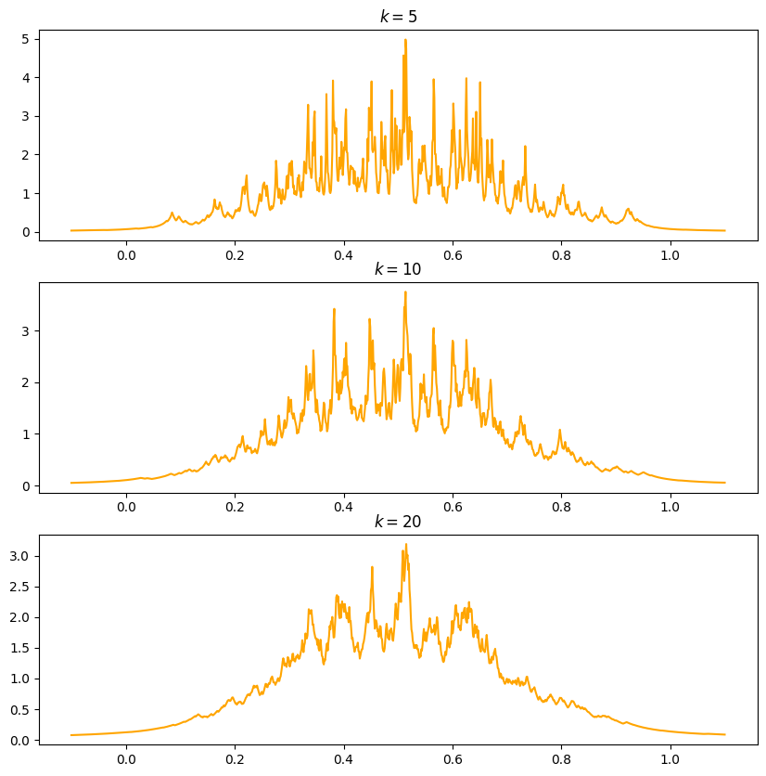
Output

Slide 15
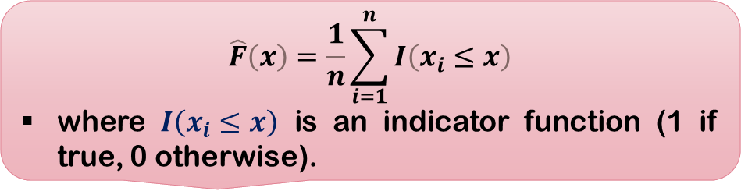
Empirical Cumulative Distribution Function (ECDF)
What is ECDF?
Why is ECDF Useful?
✔ More informative than histograms.
✔ No need to choose bin width or bandwidth.
✔ Useful for comparing distributions (e.g., Kolmogorov-Smirnov test).
Estimates the cumulative probability of a variable.
Shows how many observations are below or equal to a given value.
Formula :
📌 Example: Income distribution comparison between two cities.
$$\hat{F}\left(x\right)=\frac{1}{n}\sum_{i=1}^{n}{I\left(x_{i}≤x\right)}$$
where $I\left(x_{i}≤x\right)$ is an indicator function (1 if true, 0 otherwise).

Slide 16
Python Code to plot ECDF
import numpy as np
from scipy.stats import norm
from sklearn.neighbors import KernelDensity
# Kernel Density Estimator using gaussian kernel
X = np.random.randn(100)
model = KernelDensity(kernel='gaussian',
bandwidth=0.2)
model.fit(X[:, None])
new_data = np.linspace(-5, 5, 1000)
density = np.exp(model.score_samples(new_data[:, None]))
# print(new_data)
# Plot the densities
plt.plot(new_data, density, '-',
color='red')
plt.xlabel('Data')
plt.ylabel('Density')
plt.title('Kernel Density Estimator using Gaussian kernel')
plt.show()

Slide 17
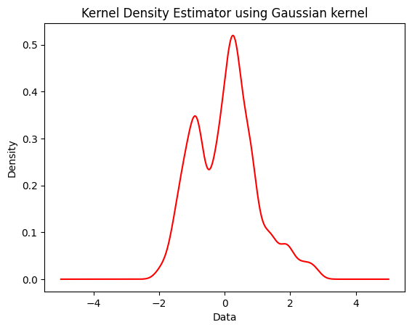
Output

Slide 18
Spline & Local Polynomial Regression (LOESS)
What is LOESS?
Strengths:
✔ Captures complex patterns.
✔ Smoothens out local fluctuations.
A non-parametric regression technique that fits small polynomials locally.
Useful for trend estimation in non-linear data.
📌 Example: Used in stock price trends and climate modeling.

Slide 19

Graph: A LOESS-smoothed curve applied to noisy data
import numpy as np
import matplotlib.pyplot as plt
import statsmodels.api as sm # Generate Noisy Data
np.random.seed(42)
x = np.linspace(0, 10, 100) # X values from 0 to 10
y = np.sin(x) + np.random.normal(0, 0.3, size=len(x)) # Add noise to sine function # Apply LOESS Smoothing
lowess = sm.nonparametric.lowess(y, x, frac=0.2) # frac controls smoothness # Extract smoothed values
x_smooth, y_smooth = lowess[:, 0], lowess[:, 1] # Plot Original Noisy Data
plt.scatter(x, y, label="Noisy Data", color="gray", alpha=0.5) # Plot LOESS Smoothed Curve
plt.plot(x_smooth, y_smooth, label="LOESS Smoothed Curve", color="red", linewidth=2) # Labels and Title
plt.xlabel("X values")
plt.ylabel("Y values")
plt.title("LOESS Smoothing on Noisy Data")
plt.legend()
plt.show()

Slide 20

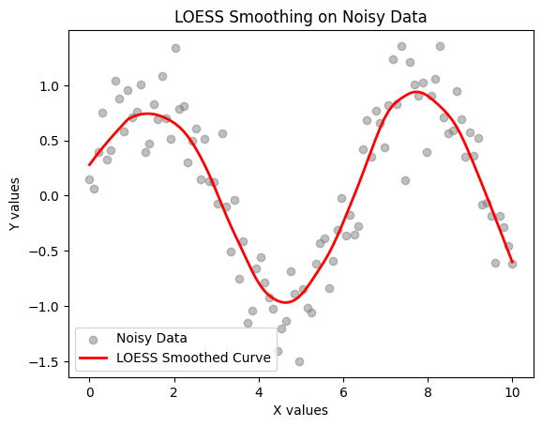
Output

Slide 21
Advantages & Disadvantages of Non-Parametric Estimation
✅ Advantages:
✔ No assumption about underlying distribution. ✔ More adaptive and flexible to real-world data. ✔ Works well for high-dimensional and irregular data.
❌ Disadvantages:
✘ More data needed for accurate estimation. ✘ Computationally expensive, especially for large datasets. ✘ Choice of bandwidth/smoothing parameters affects results.
📌 Key Takeaway: While flexible, non-parametric methods require careful tuning for accurate results.

Slide 22
Applications
📌 Density Estimation: Income distribution, species population density.
📌 Trend Analysis: Stock prices, climate data.
📌 Classification/Regression: Medical diagnosis (k-NN), real estate pricing.
📌 Hypothesis Testing: Non-parametric tests (Mann-Whitney U test).
📌 Visual: Real-world examples (e.g., KDE plot of income data).

Slide 23
Conclusion
Non-parametric estimation is powerful for analyzing unknown distributions.
KDE, histograms, ECDF, and LOESS are key techniques.
Choosing the right method depends on sample size, accuracy needs, and computation limits.

Slide 24



